Slide 1
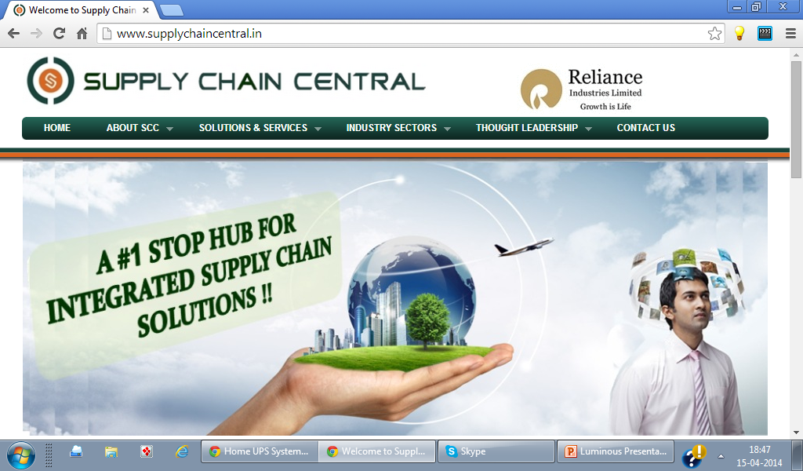
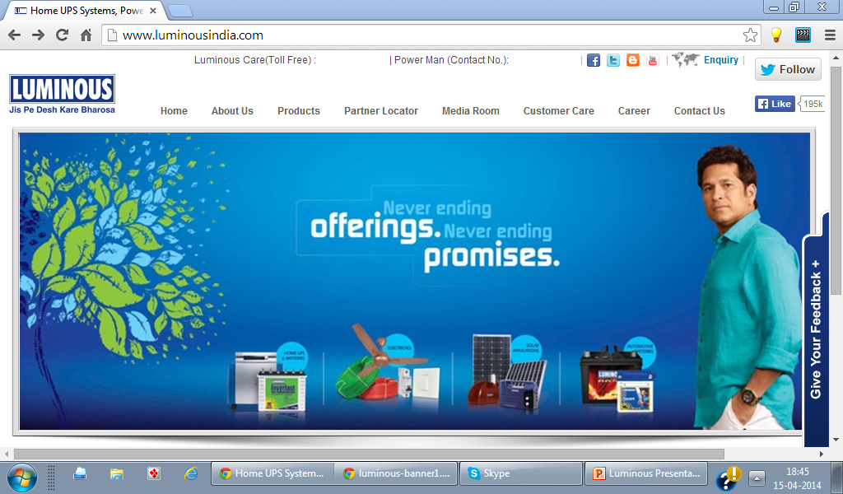

Capability Presentation by Zubin Poonawalla

Slide 2

About Luminous Power
We understand your business
Founded in 1988
Leading company with a differentiated portfolio of solutions for packaged power, diversified generation, electrical control & safety & energy optimisation.
Over 5000+ employees, 8 manufacturing units, 28 sales offices , +55,000 channel partners.
Dominating position in the domestic market & has a strong foothold worldwide.
Awarded with the 'Global Superbrands' status for FY11-12, ISO 50001:2011 certification & MNRE:CRISIL recognition.
Passionately committed to bring uninterruptible & alternate power solutions to the customers that makes their life comfortable and efficient.

Slide 3
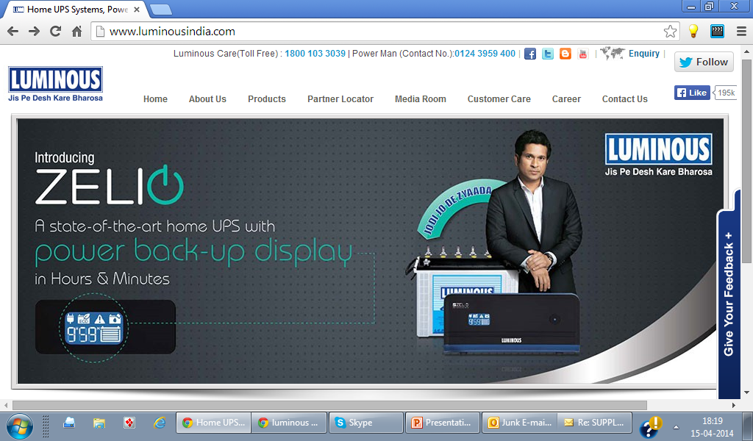
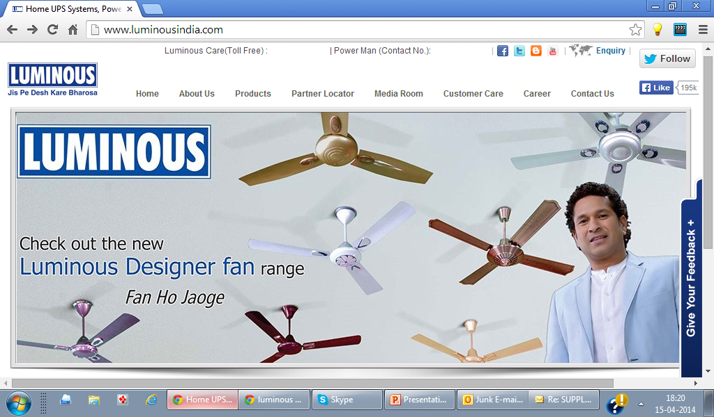
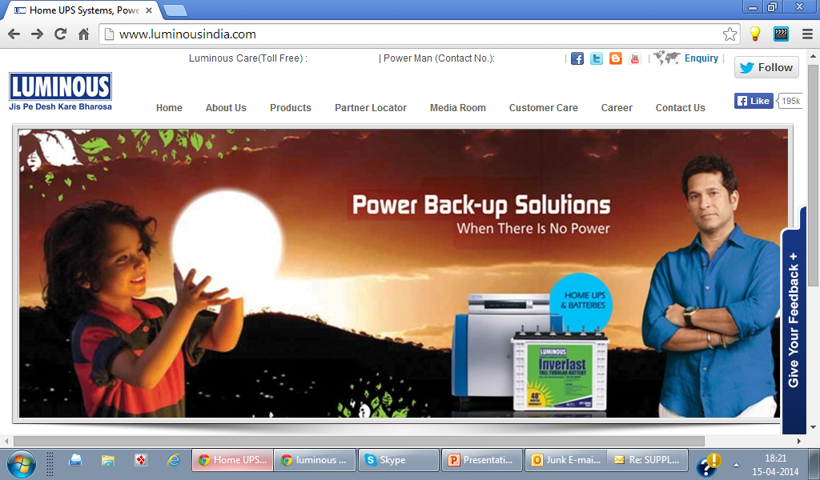
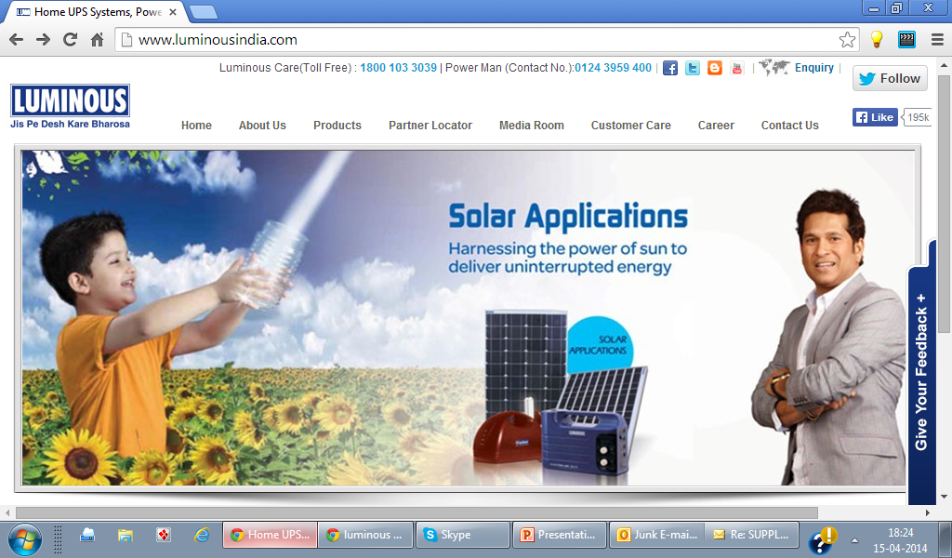
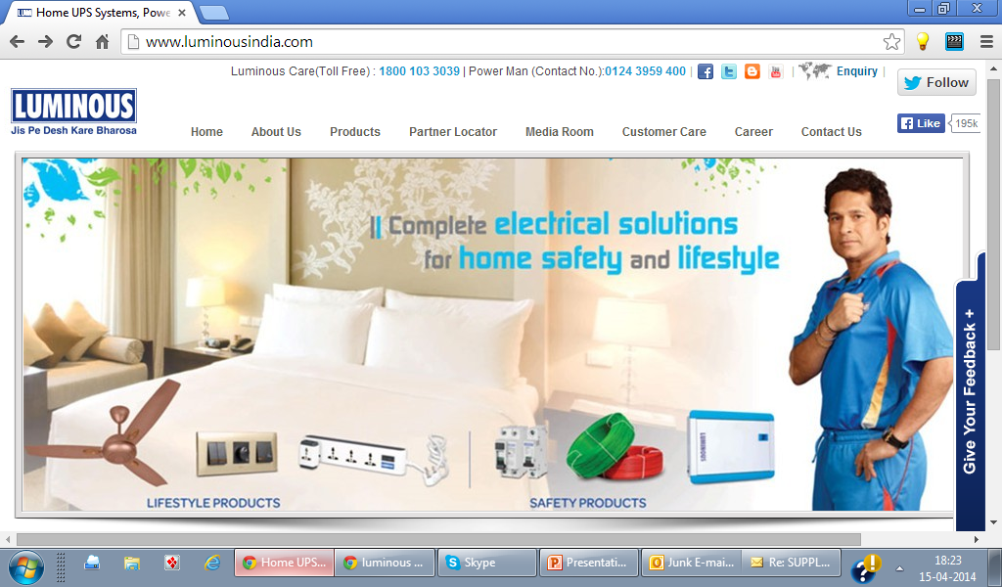
A good portfolio of products

Slide 4
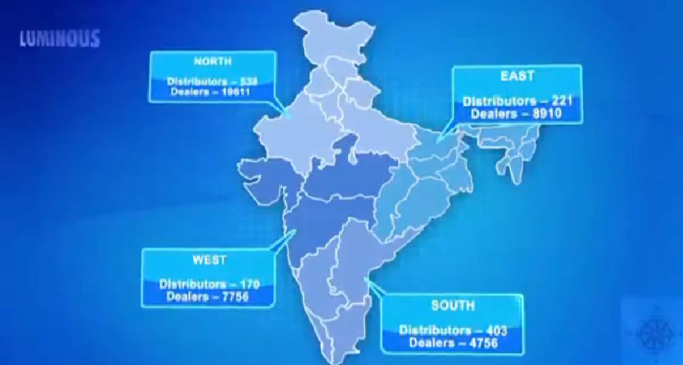
DISTRIBUTION NETWORK

Slide 5

acquires 74% of Luminous & becomes the leader in the fast-growing Indian inverter & secured power market
Luminous is a leading player in the ~€ 800 million Indian inverter & power storage market that is growing at more than 20% a year., generated revenues of INR 11.0 billion (~€ 170 million) for the fiscal year ending March 2011.
Luminous brings to Schneider Electric:
A strong brand name in the Indian market for inverters & power storage,
A diverse portfolio that includes inverters for homes & small & medium enterprises, deep-cycle batteries, uninterruptible power supply (UPS), physical infrastructure solutions for IT & Telecom, renewable energy systems (wind, solar) & engineering design & support services,
An excellent market access to the diffused distribution network with approx. 900 distributors, & over 25,000 points of sales,
A broad customer base with 3 million existing inverter users & also an access to institutional clients, in particular government & telecom sectors,
A strong service network covering all parts of the country. .
With Luminous, Schneider Electric will become the leader in the Indian inverters & secured power market & gain access to a complementary retail network

Slide 6
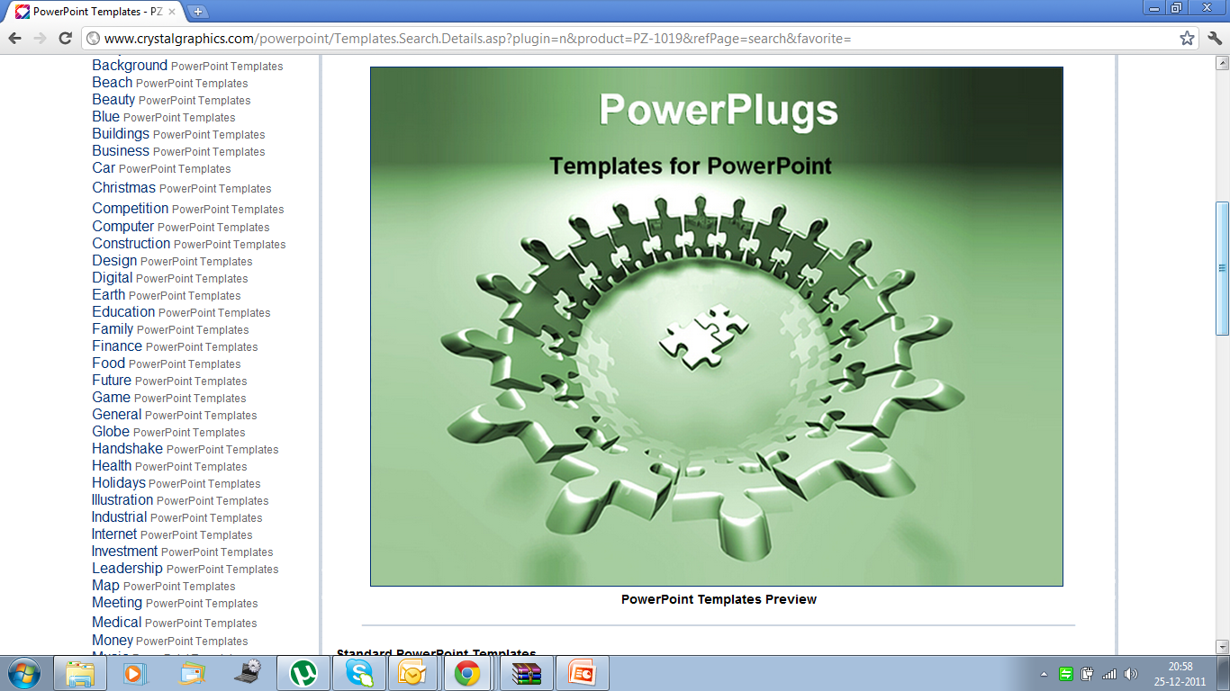

Slide 7
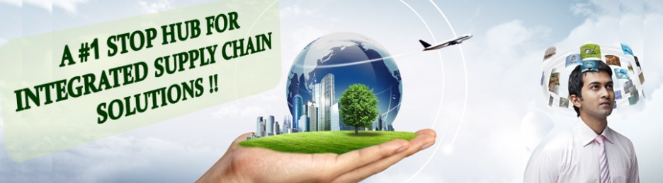
About Us
Supply Chain Management Advisory Services (SCMAS) is a consulting & solutions implementation services company focusing on Supply Chain , Operational & Project Management Excellence. SCMAS started with the vision of providing companies a platform to develop unique supply chain capabilities & projects. Executing continuous improvement projects for public & private organization & has success in several companies turnaround to profitability.
Our team comprises professionals with strong consulting experience, good domain knowledge & execution leadership.
Industries - Defence, Oil & Gas, FMCG, Infrastructure, Power, Pharmaceuticals, Lubricants, Auto Sector, e-Commerce, Consumer packaged goods &MRO.

Slide 8


Vision
2020
“To be the leading edge advisory services for integrated supply chain & project management”
Mission Statement
"To enable organizations achieve sustainable, profitable & all round growth by providing them with innovative e-2-e integrated solutions through collaborative partnership in the supply chain ecosystem“
Our Core Guiding Principles
1. Collaboration 2. Innovation 3. Integration

Slide 9




SCMAS - SUPPLY CHAIN MANAGEMENT SOLUTIONS
Integration, Optimization & Transformation
SCM Strategy & Design
SCM strategy development
Demand & Supply planning
Inventory Management
Integration & optimization of Inventory across the supply chain
Inventory planning & control
Distribution Management
Integration & optimization of distribution network
Transport planning & route
Manufacturing Operations
Sales & Operations planning
Integration & optimization of operations
Lean & Six Sigma
Theory of Constraints
Agile Manufacturing
Warehouse management systems & RFID solutions
4PL services
Planning & Scheduling
Supply chain design & architecture

Slide 10
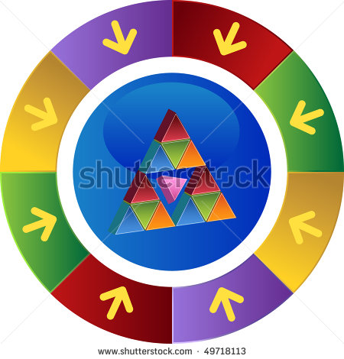

Executive Education
& Training
Supply Chain Integration & Optimization
Research
& Analytics
SUPPLY CHAIN TRANSFORMATION
Critical Chain
Project Management
TOC
CONSULTING
SERVICES
WE OFFER
4PL – Fourth Party Logistics
PROJECT MANAGEMENT
OPERATIONAL
EXCELLENCE
Media &
Events
Theory of Constraints
Lean & Agile
Manufacturing
& Six Sigma
Career Advisory
& Recruitment

Slide 11














PARTNERS AND CLIENTS

Slide 12

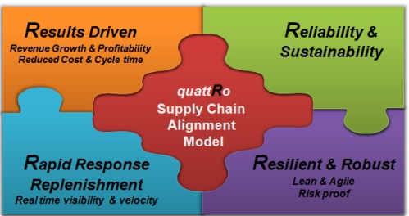
Integrated Supply Chain Management Solutions
We bring hands-on years of industry experience to bear on your supply chain challenges to help make sure supply chain initiatives deliver results aligned with your company’s most important business goals. We implement proven global supply chain models which have been constantly developed.
Our consultative & implementation support spans the entire e-2-e supply chain
Supply Chain Strategy & Planning
Sourcing & Procurement
Manufacturing Operations
Integrated Logistics, Inventory & Warehouse Management
Customer Service Excellence

Slide 13
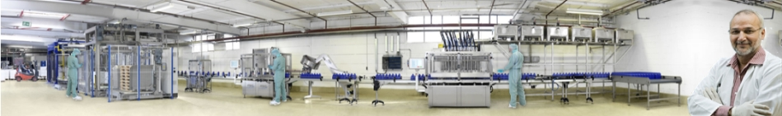
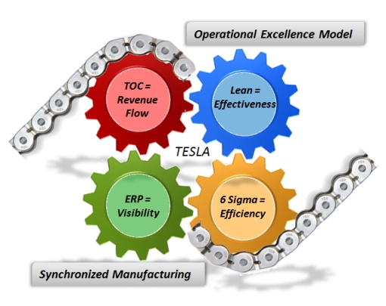
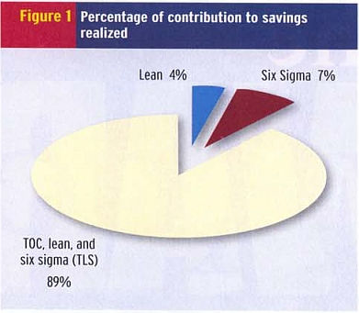
Operational Excellence for Manufacturing sector
We offer continuous improvement (CI) integrated solutions to for manufacturing operations centric organization. With our model, organizations can achieve real bottom line improvements in real cost savings & increased revenues.
TESLA : Theory of Constraints, Lean, Six Sigma, ERP Alignment – has, in double blind studies, been shown to deliver 15 times more results than Lean alone & 23 times the results with Six Sigma alone. TESLA blends the Constraints Management (ToC),Lean, Six Sigma principles & ERP systems to deliver significant bottom line returns FAST; ROI is typically 10 to 1.

Slide 14

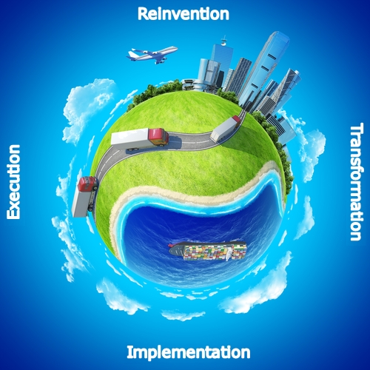
SCMAS-4PL Services : Fourth Party Logistics Model
SCMAS offers Fourth Party Logistics (4PL) services , as a supply chain integrator, we assemble, manage the resources, capabilities, & technology with our complementary service providers to deliver a comprehensive supply chain solution for you.
Central to the 4PL’s success is a “best of breed” approach
to providing services & technology to our clients.
We can leverage the capabilities of the 3PL service
providers, technology service providers, & business
process managers to deliver a comprehensive supply
chain solution through a centralized point of contact.
SCMAS-4PL will integrate the client’s supply chain activities
& supporting technologies across these “best of breed”
service providers, with our capabilities.

Slide 15
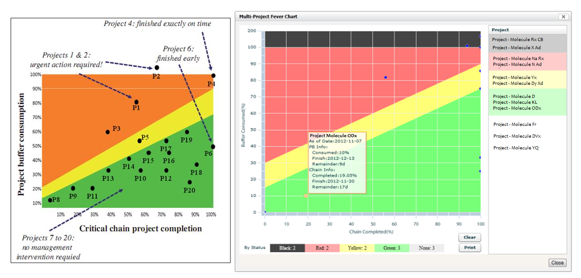
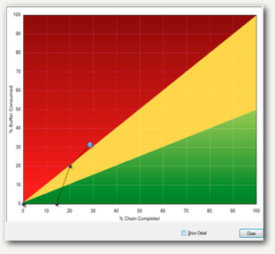
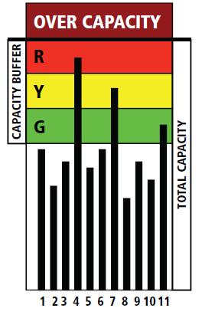
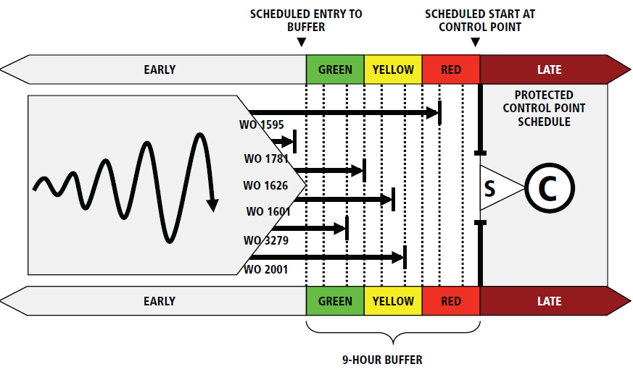
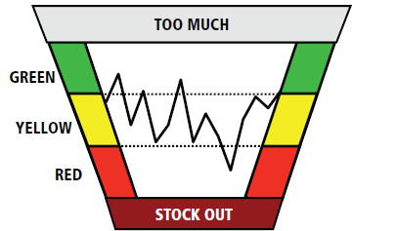
State of the art solutions in SCM & Project Management
Single Project Mgmt Chart

Slide 16


Great Potential - Battery Manufacturing Industry - INDIA
According to Lucintel's, a leading global management consulting & market research firm, Growth Opportunities in Global Battery Market to approach $86 Billion by FY16.
In India demand for batteries has been growing at an annual rate of 25% & is expected to keep growing by 25% till FY15.
The battery market in India is worth over Rs 100 billion, SMF valve regulated lead acid (VRLA) batteries have a share of 25-30 % (Rs 30 Billion) Rs 3,000 Crores

Slide 17
POTENTIAL SUPPLY CHAIN CHALLENGES YOU MAY BE FACING
PERFECT ORDER FULFILLMENT – OTIF, Due Date performance is hard to maintain with logistics & sourcing challenges
Distribution problems, with wide network replenishment will always be a challenge
Demand planning – Bull whip effect, forecasts
Responding to any marketing campaigns
Production scheduling changes due to customer order urgencies
Inventory management & control – RM, WIP & FG stocks, also distributor warehouses.

Slide 18

SUCCESS STORY – OPERATIONAL EXCELLENCE IN BATTERY MANUFACTURING INDUSTRY (Quick Glance) All in percentages only

Slide 19
Improvements at VRLA plant
Reduced total inventory levels by 35% which improved working capital situation
Increased throughput of orders by 25%
We Improved the visibility in planning & scheduling, Better layouts ensured high productivity
Improved employee productivity through better focus, control & performance, SOP established
CONFIDENTIAL

Slide 20
Our recent success at large manufacturing company, Inventory optimized by using Lean & TOC (dynamic Inventory buffer management) MTA
38%
56%
30%
63%

Slide 21
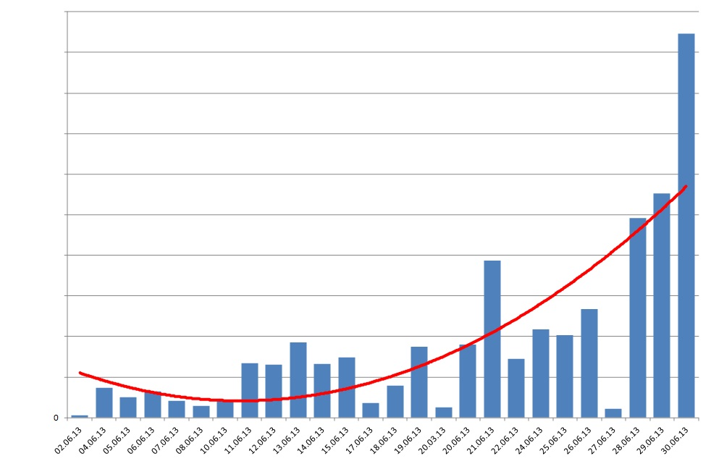
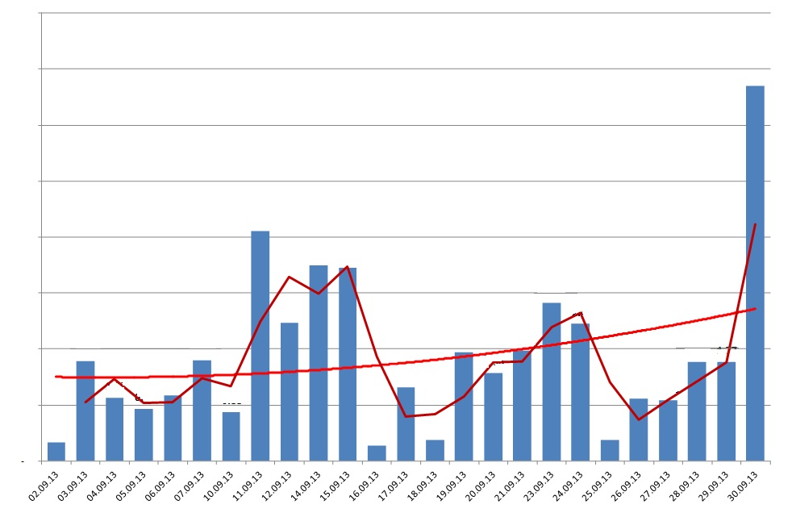
We increased throughput – speed of orders, due date performance improved to 90%
We changed the hockey stick, quatrite syndrome to evenly daily distribution…..
this helped sales achieve targets faster, customers are happier
Sales in June (before) Sales in Sept (After)
CONFIDENTIAL

Slide 22
Improved Contribution Through Faster Weekly Dispatches
33%
49%
64%
48%
73%
CONFIDENTIAL

Slide 23

Operational Excellence Model & Engagement Model

Slide 24
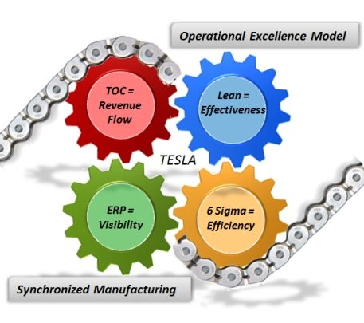
System based tools provided for operational excellence
Removing the constraints by TOC
Order Prioritization system
Buffer management system
Inventory control mechanisms
Performance management system
Inventory layouts for easier and faster work flow

Slide 25
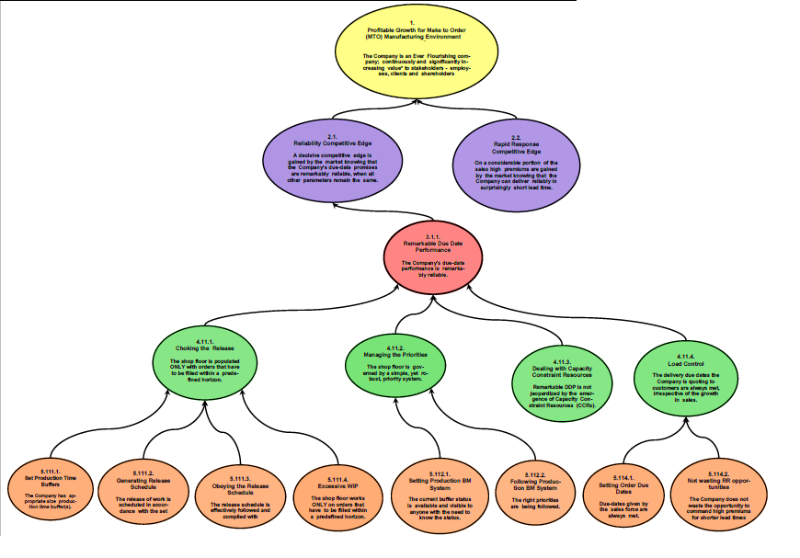
We implement Operations Excellence through a detailed Strategy & Tactics Map for our clients

Slide 26
Our Engagement Model
No | Phase | Our Approach | Status
1 | Problem Definition | Before engaging - Discuss business improvements specific to your organization, spend some time understanding your business, your goals & your market. Use this knowledge of your real business issues to verify the applicability against our proven templates, strategies & applications. (There is no charge for the Problem Definition. It is our investment. During the Solution Direction state we will discuss our results based approach including the performance payments.)
2 | Solution Direction | Present the necessary strategy & tactics in order to help your business achieve its goals. Provide you a customized solution which highlights the opportunities to deliver significant bottom line results.
3 | Buy-In of the Solution Direction | These sessions will transfer knowledge on our templates & applications & explore the applicability of these solutions for your specific situation. We will get consensus from your management team on the building blocks required, the benefits they bring & the high level plan to implement them.
4 | Implementation | Once we have agreed to move forward, together we will form a project team to develop more detailed implementation plans, clearly define the roles & responsibilities of the project team & establish a clear project review process.

Slide 27
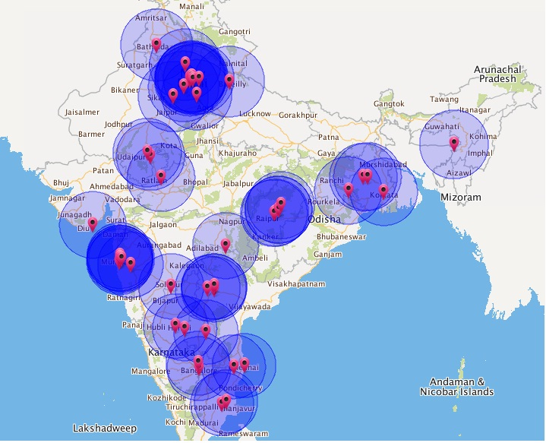

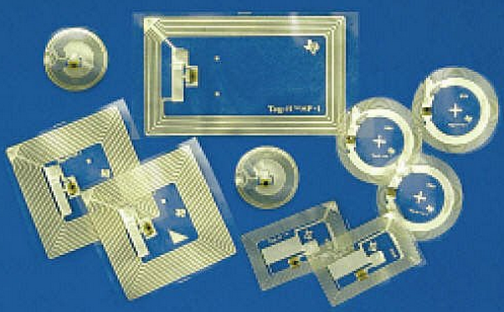
Our Technology Solutions GSM/GPS/RFID, Fleet, Asset, Inventory Track & Trace Solution in the Supply Chain - Visibility

Slide 28

Clientele who have use our tech solutions

Slide 29


Slide 30

Thank you

